Slide 1
Standard User – Contracts Navigation
June, 2013

Slide 2

Learning Objectives
Upon completion of this course you will be able to:
Move around the Contracts Home Page
Understand the basic features and components of the Contracts Home Page

Slide 3
ECM System Overview
Emptoris ECM provides the following features:
A personal home page to access all contracts and tasks that require your attention.
User groups and permission groups that together provide a highly-configurable security framework.
A contract standards library allows categorization of contract language, terms and events, and the maintenance of different sets of contract standards for each business or other organizational unit.
Ability to edit contract language using Microsoft® Word online or offline.
Note: Whenever you have a choice of using an ECM icon or a browser icon, choose ECM. For example, Refresh, Back, or Close (X). Using the browser Refresh can cause you to be logged out of ECM.

Slide 4
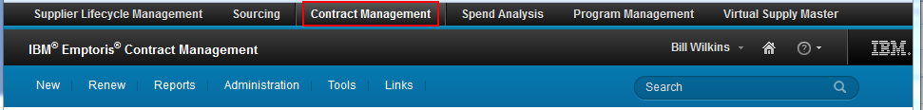
Landing Page
Depending on which Emptoris applications are installed, once you log in you are able to move between applications by clicking on the application names at the top
To access Contract Management, click on the Contract Management link.
The top area of the Emptoris displays changed substantially, but mostly cosmetically, in V9.5 and V10.0.

Slide 5
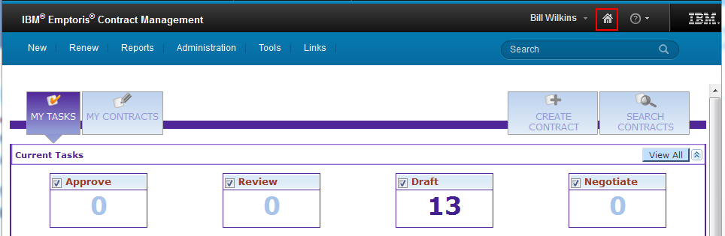
Contracts Home Page
The Home Page contains application functions and features that are available to you depending on your security settings and permissions assigned to your account.
The Top menu bar contains many features and functions.
  When you click on a Menu title (New, Renew, ...), the list of available options may be different from the list seen by another user, based on their permissions.
You can return to the Home Page at any time by clicking on the house icon at the top right. Each user can configure what his/her Home Page will display.

Slide 6
Home Page, cont.
The Navigation icons at the far right are always visible. They include:
Current User Name is shown, and the menu for that includes:
    Preferences: The user's (in SSM) are displayed and can be changed
    Logout: Logs you out of the ECM system.
Home Page (House icon): Brings you back to this Home Page display
Help (Question Mark) menu:
    Displays the ECM Context-sensitive Help system
    About Emptoris Contract Management: Displays the current ECM version and copyright information
Search (Magnifying Glass icon): Provides a list of Recent Contracts, or searches: Detailed Search, or By Folder

Slide 7
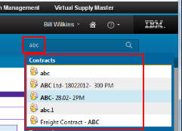
Search Options
The Quick Search Navigation icons at the far right help you quickly find contracts and objects matching your criteria.
In the Search field to the left of the Magnifying Glass icon, type a few letters and a “contains” search result will be returned; click a hyperlink to open the object.
    In this example, contracts with “abc” or “ABC” in their names are listed.
Search icon – click the Magnifying glass icon, and a menu appears:
  Recent Contracts: Returns a list of your 10 most recently accessed contracts
  Detailed search: Provides the ability to enter multiple criteria for a search
  By Folder: Search for a contract via a specific folder

Slide 8
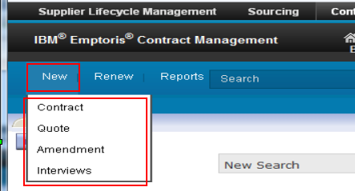
“NEW” Tab
The system offers different options for you to access information.
The New tab provides another quick way to create a new contract, quote, or amendment. It also provides an entry to the Interview Designer, where you can manage interviews or run one to create a contract.

Slide 9
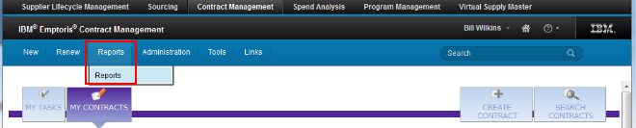
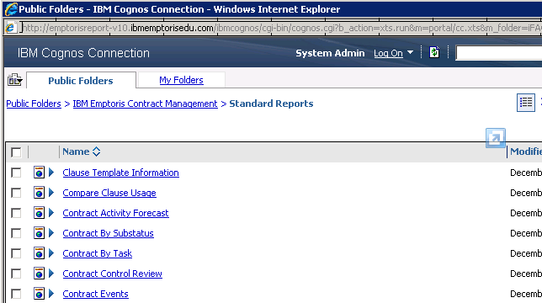
“Reports” Tab
The Reports tab takes you into IBM Cognos Connection, where Standard Reports can be run. (If single sign-on was not configured properly, you first get a login screen for IBM Cognos). We will cover Reports later.

Slide 10
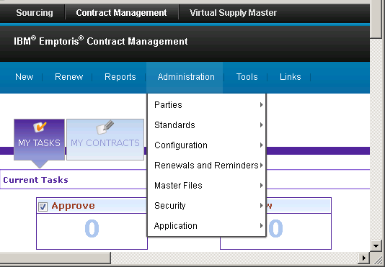
“Administration” Tab
The Administration tab has several menus that provide access to many functions.
The menus and functions that are visible are highly dependent on the user's permissions.
E.g., under the Standards menu, the following functions are available:
  Clause Types
  Clause Templates
  Contract Classes
  Contract Templates
  User-Defined Properties
  Term Definitions
  Interview Designer

Slide 11
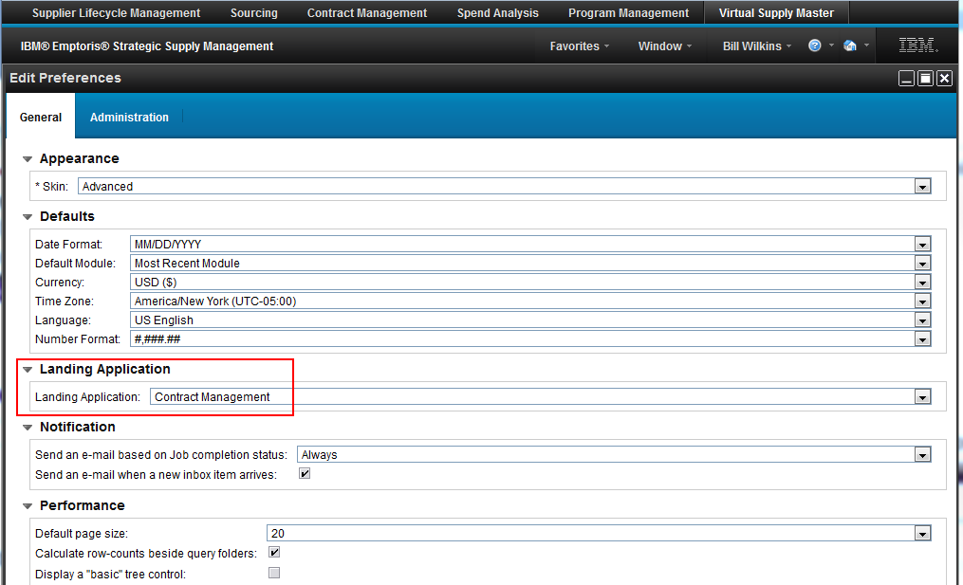
“Preferences” Tab
Preferences allows you to customize your settings. In V10, clicking this takes you into a Strategic Supply Management (SSM) window; i.e., it applies beyond just ECM.
On the General tab in Preferences you can set your Landing Application to be Contract Management. That is, in future, when you sign in to SSM, you will start in ECM instead of Sourcing, for example.
Click OK at the bottom (not shown below).
(Note that there is a batch import facility in SSM. Among other things, it lets you bulk load users, and while doing that set their Landing Application and Landing Page values.)

Slide 12
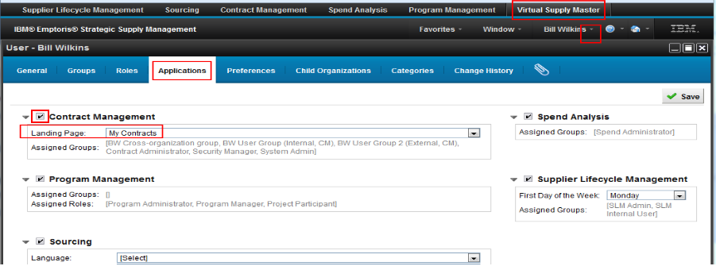
User Profile in SSM/VSM
In addition to setting Preferences, you can do user-specific application tailoring in Strategic Supply Management, through the User Profile.
Click on Virtual Supply Master, then in the menu beside the logged in user's name (at the top right), select “Profile...”.
On the Applications tab, make sure that Contract Management is checked, and below it, set your Landing Page: it can be My Contracts or My Tasks, or a Search window.
Make your choice and Save (top right). You can change this setting at any time. Even though this is in SSM/VSM, you don't need to be an administrator to make these changes.

Slide 13
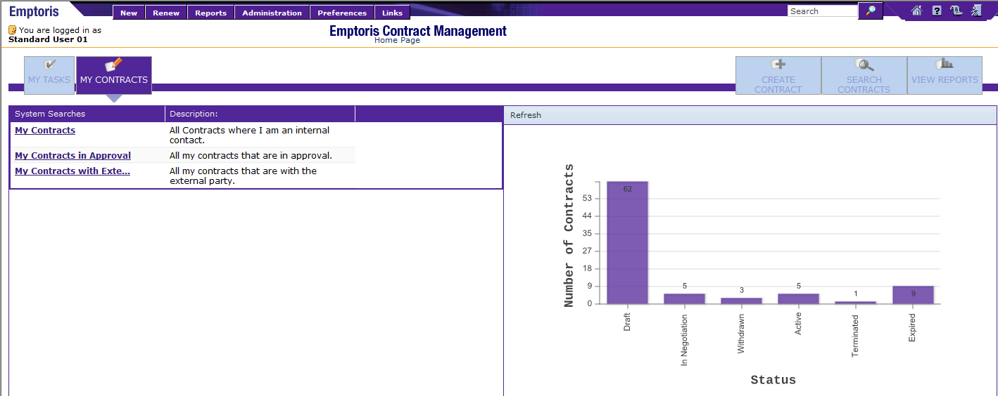
My Contracts
The My Contracts tab contains the contracts that you ‘own’.
The System Searches section displays contracts by type:
  My Contracts: All contracts where you are an internal contact.
  My Contracts in Approval: All of your contracts that are in approval
  My Contracts with External Parties: All contracts that are with an external party
You can't add searches to the System Searches list, but you can create your own searches, as we'll see later.

Slide 14
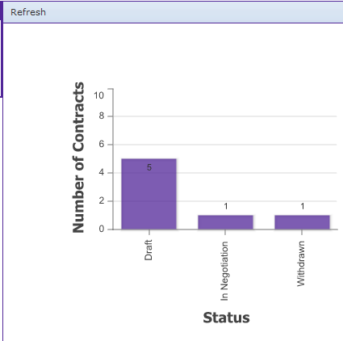
My Contracts (cont.)
The Graphical Format section displays contract categories by their status and the number of contracts in that status in graphical format.
Status values include:
  Draft
  In Negotiation
  Withdrawn
  Executed
  Active
  On Hold
  Termination Pending
  Terminated
  Expired
From here you can go directly to
the list of contracts for that status.
  Click in the bar of the status; for
  example, click in the Draft bar to
  display the 5 contracts currently in
  Draft status.

Slide 15
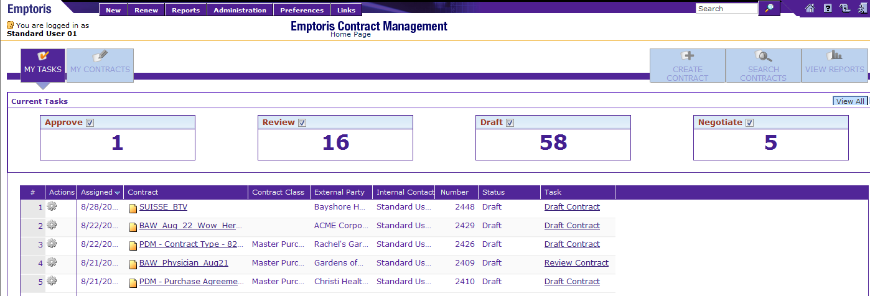
My Tasks
The My Tasks tab contains a list of actions that you need to perform.
They can be actions created by you or assigned to you from some other user, such as a request to review a contract.
The Current Tasks can be filtered to display only those tasks where you can:
  Approve a Contract
  Review a Contract
  Work on the Draft of a Contract, or
  Negotiate a Contract
Click the check box in the task box to view the list; check again to remove it.
You can expand or collapse this view by clicking the View All arrow on the right.

Slide 16
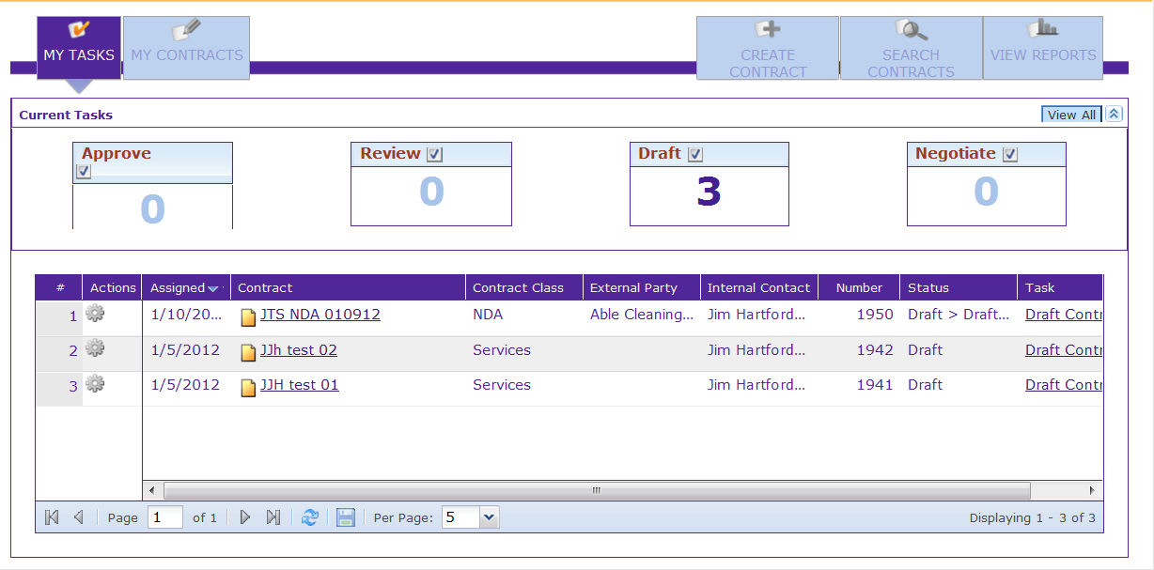
My Tasks (cont.)
The options in the Actions column (click on “gear” icon) include:
  View Pending Tasks: Displays all ‘Open’ tasks such as Review Contract of Approve Contract tasks associated with the selected/highlighted contract. This is extremely useful.
  View Activity Log: Displays all actions associated with the selected/highlighted contract.
  View Contract Properties: Displays the list of contract properties (those found on the Header tab) associated with the selected/highlighted contract.
  View Contract Summary: Displays the Contract Summary information

Slide 17
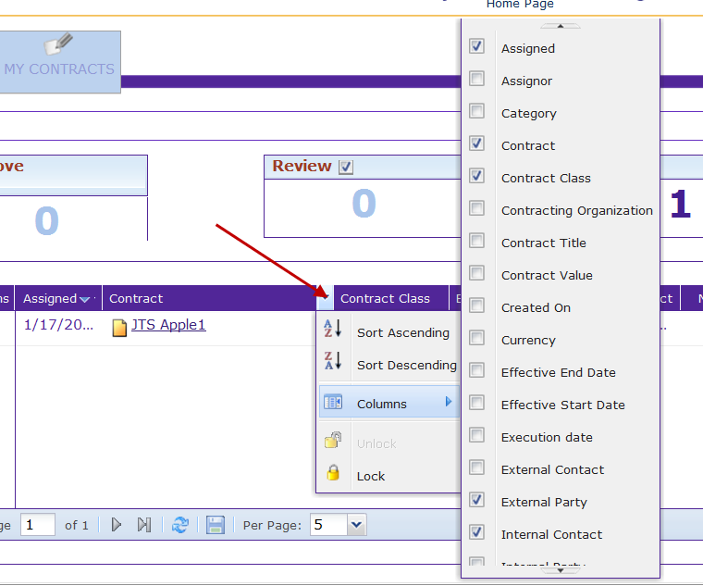
My Tasks (cont.)
You can reconfigure the columns on the My Tasks and My Contracts lists to display a wide variety of information.
  Click the Column drop down menu
  Select the Columns menu option on the Columns drop down menu
  The Configure Columns list is displayed. Click a check box to select (or deselect) the information in the list.
  The information is added as a column.
We suggest not tailoring My Tasks until after Acceptance Test.

Slide 18
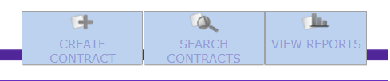
Home Page Navigation
The three buttons to the right of My Tasks/My Contracts allow you to Create Contracts, Search for Contracts, and View Contract Reports.
The Create Contracts menu lets you create different types of contracts using the templates or interviews available in the system.
The Search Contracts menu lets you search for contracts that are available in the system.
  The contracts searched by the selected criteria are displayed in the result grid.
  The result grid gives you the option to perform contract related tasks either on one contract or on a collection of contracts.
The View Reports menu lets you view the saved reports to which you have access permissions.
  You can select the reports from the Favorite Reports section and view them.

Slide 19
Landing Page Choice by Role
There are two main roles, and one secondary one, that ECM users play:
  Those doing work on an on-demand basis, especially as Reviewers and Approvers. My Tasks is the best landing page for these people, unless they serve as Internal Contact for contracts, in which case My Contracts is probably a better choice.
    An additional suggestion is to have such people work first on Approval tasks, then Draft tasks, then others.
  Contract creators. For these people we suggest a landing page of My Tasks, because the Draft task will be immediately visible there and is the first task to be dealt with for new contracts.
  Those with an oversight role (e.g., managers). For these people, Search Contracts may be the best landing page.

Slide 20

Questions?

